Slide 1

Think Equity Diversity & Inclusion
Notes:
SLIDE ONE
Sophie: Firstly, let me introduce myself. My name is Sophie Mason I am a white female Aged 35 short blonde wavy hair wearing a bright pink jumpsuit. I am joined by my friend and colleague Merryn Roberts Ward, a white female with long brown hair.
We are here today to talk about reasonable adjustments. On the screen beside me is our first slide which shows a purple background and the Thinkedi logo, which is the organisation I founded in February this year. Thinkedi stands for Think EDI (equity diversity and inclusion). Which is why the logo itself is a light bulb above an =.
- Talk about my conditions and being a carer.
- Talk about Marie and what I learned from that.
- Talk about my career and the barriers I have faced but how I overcame them.
- Talk about adjustments and why they’re so important because we all have protected characteristsics.
It should not be about ‘helping others’ It should be about recognizing the privilege we have and using that priviledge to remove barriers for others.
So what happens if we don’t remove barriers.
- talk about equality act 2010 – types of discrimination

Slide 2

What is an adjustment?
Notes:
Merryn: On this next slide is a pale grey background with our purple and green thinkedi logo, are the words 'What is an adjustment?’
Adjustments can be called accommodations. They are adaptations to how we do things that allow everyone to experience the same outcomes in health, safety, wealth, connection and meaning in their lives.
Some adjustments I have helped employees implement include…(discuss)
As a line manager it can be difficult to remember all the adjustments you need to put in place….(discuss)
One off training isn’t enough…(discuss)
Adjustments are intended to give us social mobility so that for equal effort, we can all receive equal gain.
In theory when the right adjustments are made for everyone, no one will be left behind due to disadvantages out of their control. We’re just not quite there yet.

Slide 3
127 BILLION
Notes:
SLIDE THREE
Merryn: This next slide is grey with the purple-green thinkedi logo and says 127 billion. Which is the amount of money the UK Economy spends on discrimination each year.
We know that the cost of discrimination is in more than money, it affects mental health, physical health, social well-being and reduces life expectancy.
Its no surprised that at the moment 46% of disabled people are unemployed
Through my career I've seen how it affects organisations too with sickness rates, attrition, grievances.
So with discrimination costing so much, why hasn’t anyone put in place a tool like Thinkedi before now?

Slide 4




Notes:
SLIDE FOUR
Sophie: Because the processes we use just don’t work for the world we live in and taking a proactive approach means a complete upheaval. Unless of course someone develop and online system called Thinkedi. If we look at the process at the moment there are some key flaws.
This next slide is grey with the purple-green thinkedi logo and has 4 icons or pictures on which I will describe as we go through them.
Explain icons are for process
The first icon is a question mark. – Describe how people don’t know
The second logo is of a pen and paper. – describe the process of letter writing, explain disability administration tax.
Merryn: The next icon is in the shape of a person. This is the person in the organization, maybe the line manager or supervisor who receiving the adjustment request. It could be a teacher, doctor or nurse too. Why do we assume that this person doesn’t need adjustments of their own? Perhaps they’re dyslexic or have visual impairments themselves. Everyone has at least one protected characteristic and everyone will benefit
The final icon is two arrows that travel around in a circle.
This is to describe 'change'. Nothing stays the same. Line managers change, buildings change, teams change. we change jobs. We work contract jobs. Covid happens and we're sent to work from home. A few years later it's all back to the office. the most consistent thing there is, is change. So, adjustments that were right last year may be different now.
We have a long way to go with learning to understand others and make adjustments. But Thinkedi really is a revolution that is going to take us a huge jump forward towards inclusivity. The future is bright!

Slide 5

RESOURCES
UNDERSTANDING
ACCOUNTABILITY
INCLUSION
Notes:
SLIDE FIVE
Sophie: Thinkedi works because we have considered all of this
To show this, on this next slide is a triangle diagram separated into three sections. Each section is labelled understanding, accountability, and resources.
We know that discrimination, or failure to make and keep adjusting, is caused by a lack of understanding which may or may not come from privilege. So Thinkedi works to increase an individual’s understanding of different characteristics and conditions.
Merryn: We know that discrimination, or failure to agree and keep adjusting, is also caused by a lack of accountability from managers and government institutions to uphold the law. So Thinkedi also works by
Sophie: We also know that even with the greatest understanding and individuals being held accountable, it’s difficult but not impossible without resources. So Thinkedi helps plan and allocate those resources.
Let’s look what Thinkedi looks like on the user side.

Slide 6
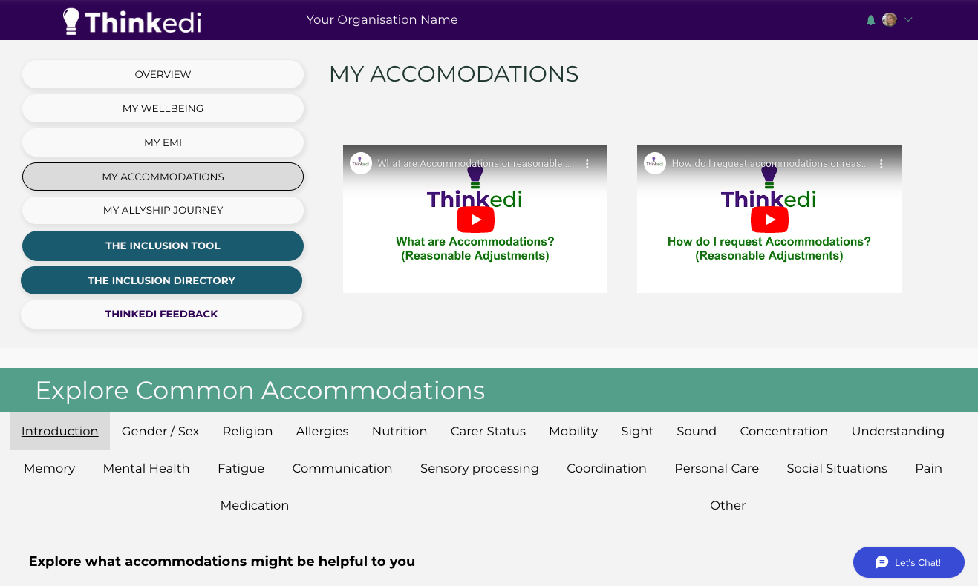
Notes:
SLIDE 6
Sophie: This is the My Accommodations page of our Thinkedi app. The top banner is purple with our Thinkedi logo in white. To the left is a stack of rounded rectangles which form our menu. This is where you can access all the free Thinkedi tools including MY EMI or equality monitoring infomation, My Accommodations, My Wellbeing, My Allyship Journey, The Inclusion Tool, the inclusion directory and your overview. To the right are two videos labelled ‘what are accommodations/ reasonable adjustments’ and ‘how do I request accommodations/ reasonable adjustments?’
Below is where you can explore common accommodations. Here you can select any other these tabs for example gender, mobility, sight, hearing, concentration, memory, fatigue and much more. And each of these will enable you to explore common needs and adjustments or input your own.
It’s fully integrated for web inclusivitity with adaptable content, colour and navigation adjustments.
So here is where you can explore common accommodations that other people ask for. We find that this really helps people to combat this stigma around requesting accommodations and helps them understand what kind of adjustments have been accepted elsewhere. This makes people more likely to request what they need for a quality and inclusion. We follow the social model of disability meaning we focus on the things that you need an affect you rather than diagnosis. At every point there is a video and description to help you understand your rights and how to use the platform to your benefit. You can store your equality monitoring information and even explore a feed of resources which you can tailor to your own requirements. The key thing with any information that you share with Thinkedi is that we will never share this with any other organisation without your consent you will always have control over who you connect with and who you share your information with. So, if you change employment you can connect with your new employer and disconnect your information from your previous employer keeping your information safe where you want it.

Slide 7
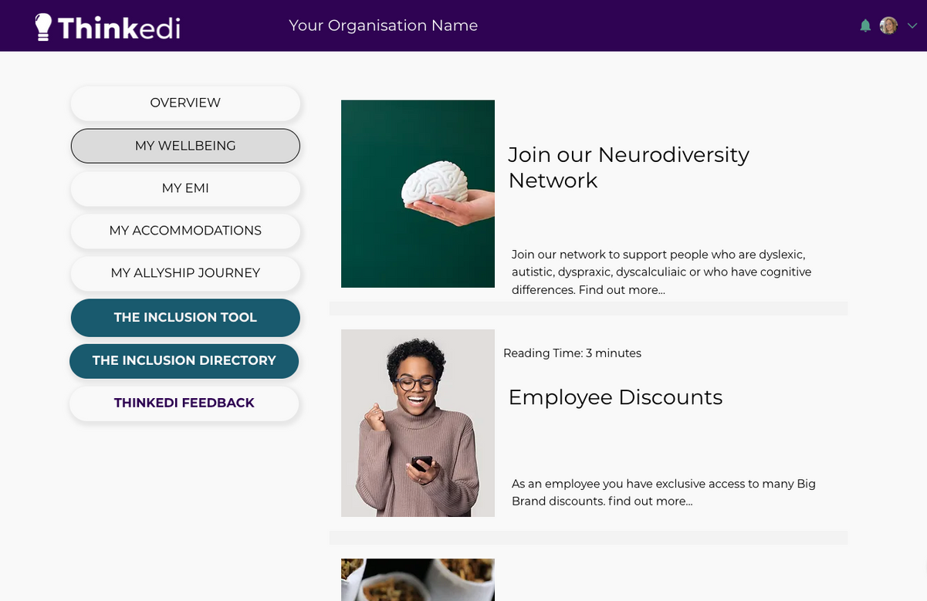
Notes:
SLIDE 7
Sophie: This next slide shows the My Wellbeing page which has the same banner and menu as well as a scrollable feed of articles with pictures, titles and links that taks you to resources for support. We listened to our first users who said they wanted a single place to find support in their areas. We now work with charities and organisations to share linked to events, training, support offerings and much more so that it’s easily searchable and found when you need it.
We also have an allyship journey page where you can learn about people with different characteristics and expand your understanding to reduce bias. There is so much more we want to do but its important to use we listen to our users and build what is needed the most and will make the most difference.
Merryn is going to tell you a little more about the organisation side of our app so you can understand how we support organisations to support inclusion.

Slide 8
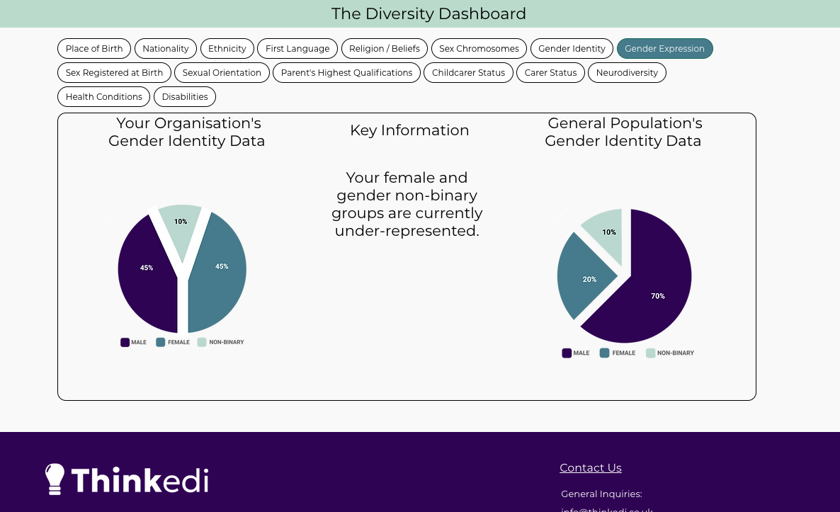
Notes:
SLIDE 8
Merryn: Describe and discuss the Diversity Dashboard

Slide 9
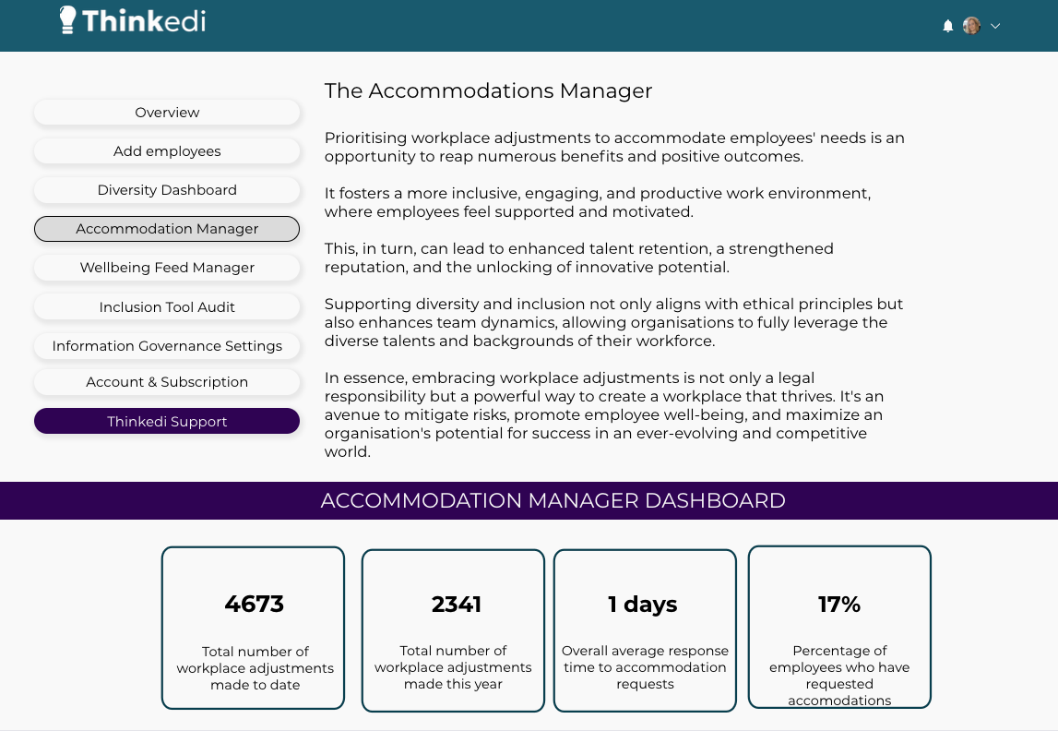
Notes:
SLIDE 9
Merryn: Describe and discuss the Accommodations manager

Slide 10
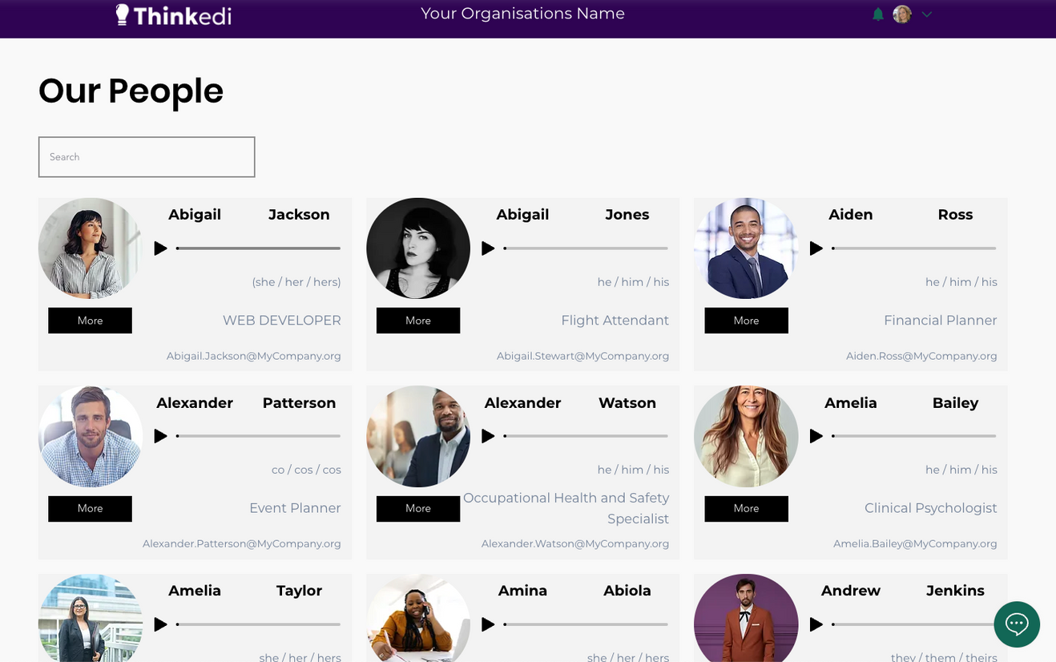
Notes:
SLIDE 10
Sophie: Describe and discuss the Organisation Directory

Slide 11
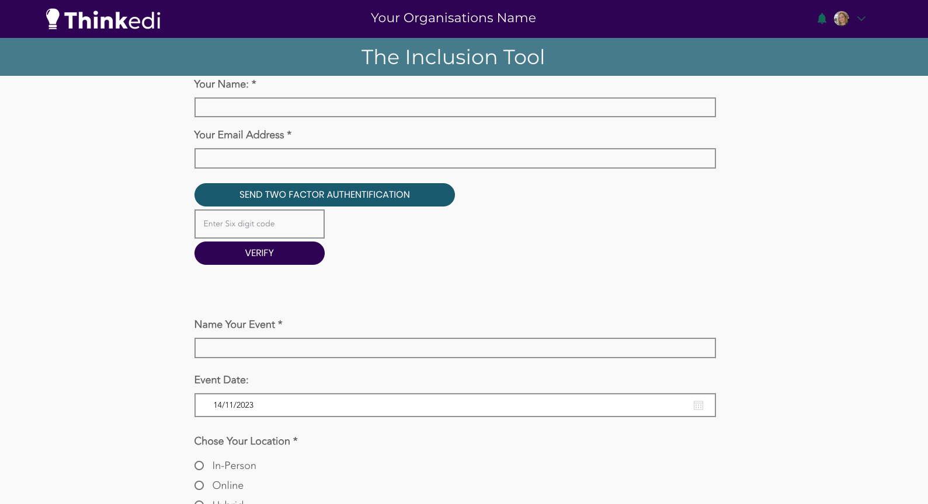
Notes:
SLIDE 11
Merryn: Describe and discuss the Inclusion Tool

Slide 12
Notes:
Merryn: As I take over from this next slide, which shows a white thinkedi logo on a graduated green background, I want to tell you what Thinkedi does.
Thinkedi is a free online web platform where you can set up a profile, store your equality monitoring information and explore adjustments or accommodations that other individuals ask for. You can choose which accommodations would suit you, or create you own and them request them from an organisation. You can also explore a feed of services from the charities and public services relevant to you.
We then support organisations to connect with you and we support them to go through the digital process of agreeing to your adjustment or finding a suitable alternative. This means they have a standardised way to respond, and everything is tracked so they can monitor how efficient they are at putting things in place promptly.
Sophie: We then provide the tools for the organisation to remember these agreed adjustments in day-to-day work, whether line managers change or you working with a different team.
And when you finish working for an organisation you can disconnect your data meaning it leaves no trace. You are always in control of who knows what. Also, Thinkedi is intensely cyber-secure and will never sell data. It is all about communicating your needs.
Merryn: And our goal is that everyone will have a profile to support them across their lifetime. We are working with fantastic partners across childcare providers, education, health, the charity sector, employment and social care so that the thinkedi platform can support individuals to gain inclusive access wherever they go.
So what is our ask of you? Go and sign up at www.thinkedi.co.uk, and help us test and grow our platform. Tell us what you need. Tell us what would make it work for you. Tell us what it does well. Tell us your reservations and let's make this revolution happen together.
Sophie: That is the end of our presentation. But we'd love to answer any questions you might have.

