Slide 1
Sinead Fitzpatrick Senior Speech and Language Therapist Director of Clinical Therapy Services at ChildVision

Slide 2
Clinical Markers of Autism
Pointing
Gesture
Unusual Eye Contact
Facial Expressions
Shared Enjoyment Interaction
Showing
Joint Attention
Social Overtures
Social Communication
Rapport?
Idiosyncratic Use of Words or Phrases
Unusual Sensory Interests
Hand/Fingers complex mannerisms
Unusual interests or stereotyped behaviours

Slide 3
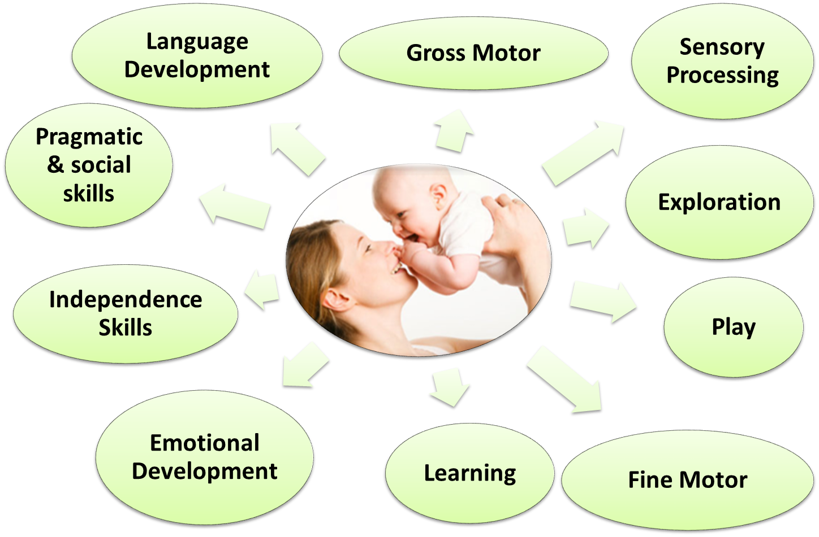
Areas of General Development which can be impacted by Vision Loss
Notes:
Canaan Barrie
Many children with vision impairment and complex needs have significant difficulties processing and interpreting auditory and visual information. Spoken words and manual signs are fleeting and usually bear no direct resemblance to the items they refer to.
Some children with vision impairment and complex needs frequently move in and out of alertness, and this may be especially true of those who also have poorly-controlled epilepsy.
In addition, many children with vision impairment and complex needs have difficulty focusing their attention. It is not surprising, then, that they often fail to attend to something as brief as a spoken word or manual sign. Their difficulties continue even if they do attend. This is because they also process information slowly. By the time they have interpreted and understood what they have heard or seen, events may well have moved on, leaving them confused.
Some children with vision impairment and complex needs find it is easier to understand when
to attach a special meaning to an object, that object is regarded as an "object of reference".

Slide 4
Milestone | Sighted Child (age in months) | V.I. Child (Age in months)
Lifts head in prone | 1-1½ | 4
Propped on elbows in prone | 3 | 8-9
Selective reach in prone | 5 | 10-12
Rolls supine -prone | 3-4 | 5-8
Independent Sitting | 5=6 | 6-9
Floor – Sit | 7-8 | 11
Pulls to stand | 8-9 | 13-15
Crawls | 9 | 14
Stands independently | 11 | 16
Walks with HHA | 9-11 | 18
Walks independently | 12-15 | 20-21

Slide 5
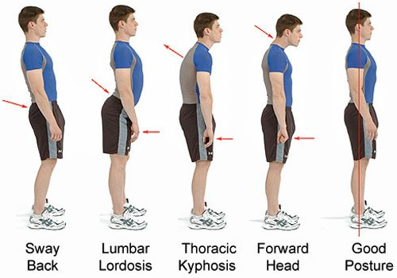

Slide 6
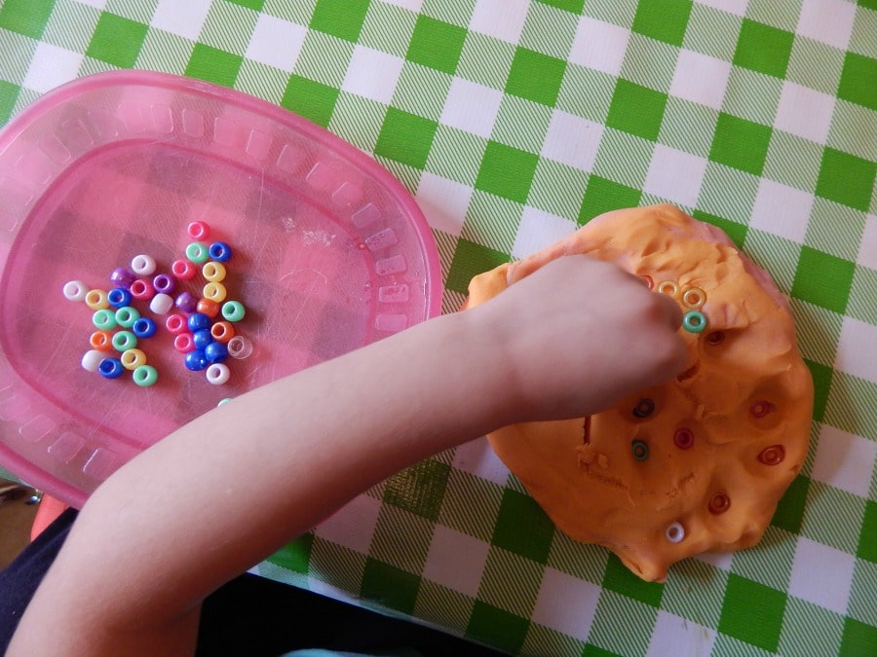
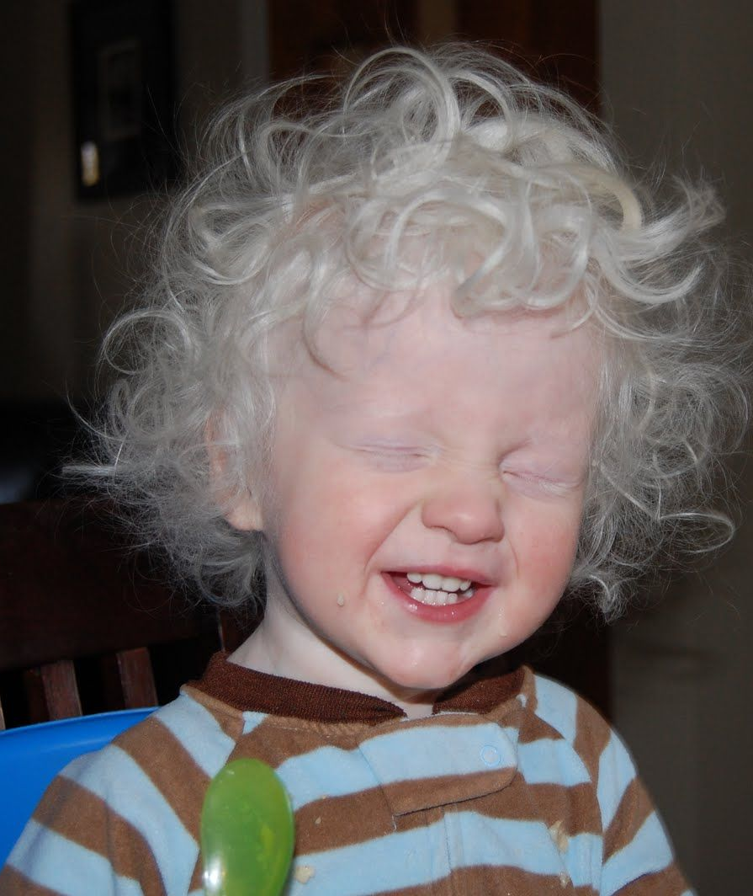
Finger isolation
Using touch
Refined grips
Using tools
Dexterity/Manipulation
Forearm Rotation
Bilateral integration
Tactile Searching

Slide 7
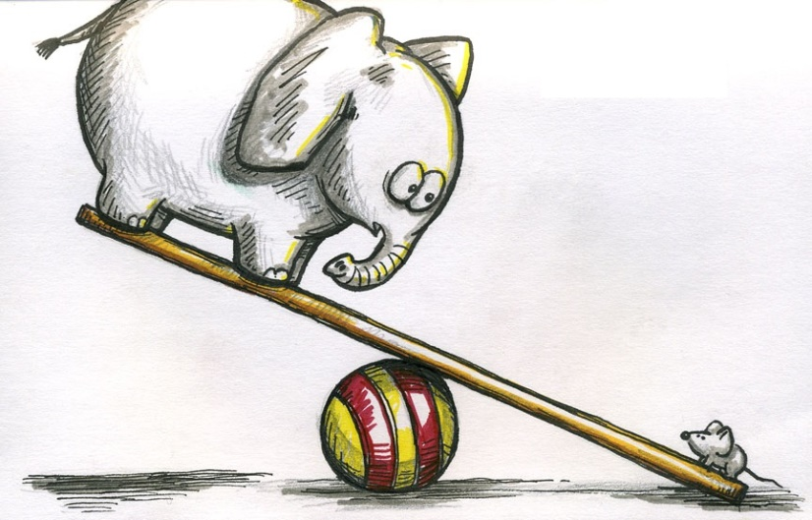
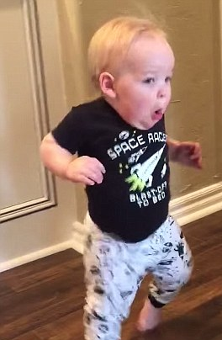
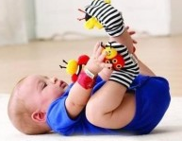
VI Related Behaviours
Imbalances in the Sensory System
Decreased Awareness of oneself and the Environment
Auditory Sensitivity

Slide 8
Use fewer (plurals & prepositions)
Morphology (smallest parts of words)
Reversal errors
Limited Vocab
Pronouns (12 months delay)
Similar to sighted peers
Syntax (sentence structure)
No differences from sighted peers
Speech sounds (phonology)
Experiential learning

Slide 9
Clinical Markers of Autism
Pointing
Gesture
Unusual Eye Contact
Facial Expressions
Shared Enjoyment Interaction
Showing
Joint Attention
Social Overtures
Social Communication
Rapport?
Idiosyncratic Use of Words or Phrases
Unusual Sensory Interests
Hand/Fingers complex mannerisms
Unusual interests or stereotyped behaviours

Slide 10
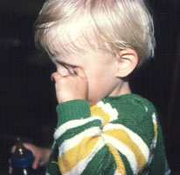
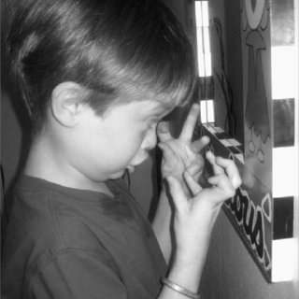
Blindisms are stereotyped behaviors sometimes found in visually impaired toddlers or children. Blindism behaviors range from body rocking, head swaying, eye rubbing, head banging, spinning to finger flicking. These behaviors are repetitive and serve no specific goals, but can calm or soothe children if they are distressed.

Slide 11
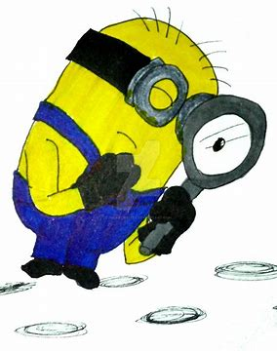
How we assess for ASD in the visually impaired community
Functional Vision Assessment (FVA)
Autism Diagnostic Interview Revised (ADIR)
Autism Diagnostic Observation Schedule (ADOS)
Background:
Therapy reports: SLT, PT, Psy, OT
Observation profile
School questionnaires

Slide 12
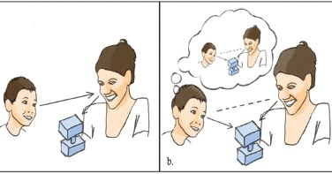
Joint attention is defined as the coordinated process of attention between two people and an object or event, with both involved parties recognizing and acknowledging the other’s interest in the object or event (Bakeman & Adamson, 1984; Eilan, 2005; Tomasello & Dunham, 1995)

Slide 13
Pointing
Index finger pointing typically emerges between 7-11 months of life
Function?
To ask for something (imperative pointing)
To draw someone’s attention to something (declarative pointing)
Pointing as a means of screening for language development Stams, Koster and Noom (2010)
It shows us that the baby can get someone’s attention, send a message, and attempt to influence someone’s actions or reactions to whatever it is he is pointing to.
Looking at the function of pointing, how do children with VI ask for something, draw our attention to something?
-Commenting on a noise; Did you hear that? What’s that sound?
-People with a VI do point, it may not be accurate but they often point towards sound heard or towards person speaking-depending on the purpose of their point!
-They will often orientate their body to the noise/object and comment

Slide 14
Types of Gesture | Examples
Deictic Gesture –pointing (10 months) | Drawing attention to something of interest
Ritualized requests (9-13 months) | Open/closed grasp request to object
Play schemes (12 months) | Driving a toy car steering wheel
Iconic gestures (before a child has obtained 25 words) | Gesture to show an aspect of item or action they represent. Blowing to indicate bubbles. Hand to mouth gesture if child sees a hot cup
Gesture +speech combinations | Information that complements the spoken message 1st-point to a car and say “car” 2nd-point to a car and say “red”

Slide 15
Function of Gesture; | Compensatory Skills Used
Draw attention to something | Often use quite descriptive language, describing in detail what caught their attention
Request | Whole handed point in the general direction of the object
Pretend play | With support, no difficulties. Often limited to their experiences as missing out on incidental learning.
To demonstrate an action | Better with gross motor, whole body actions. Again based on experiential learning. Generally no difficulties demonstrating an action or performing a mime once it’s part of everyday, familiar routine
Information to complement spoken language | Varied intonation, pitch and volume of voice used frequently to compliment spoken language.

Slide 16
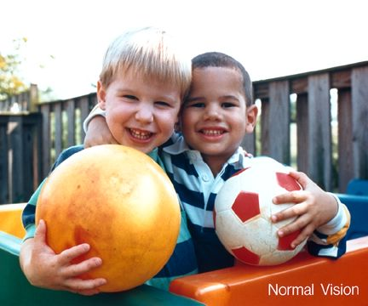
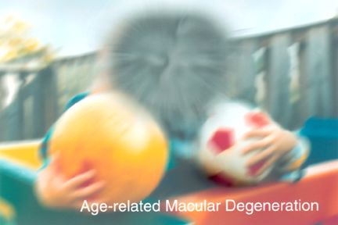
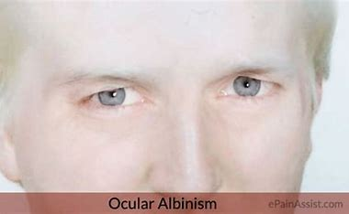
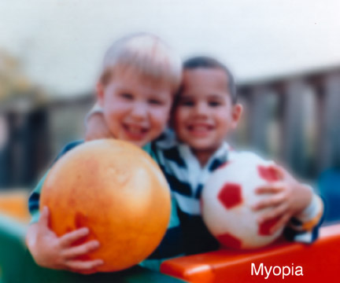

Slide 17
Eye contact- engagement, connection
Using the vision available to them, how does a person with a VI make that engagement, connection with communication partners;
-Body Orientation
-Head tilt
-Touch
-Matching intonation
-Shift in facial expression, subtle changes of intonation to match communication partner (Situation dependent)

Slide 18
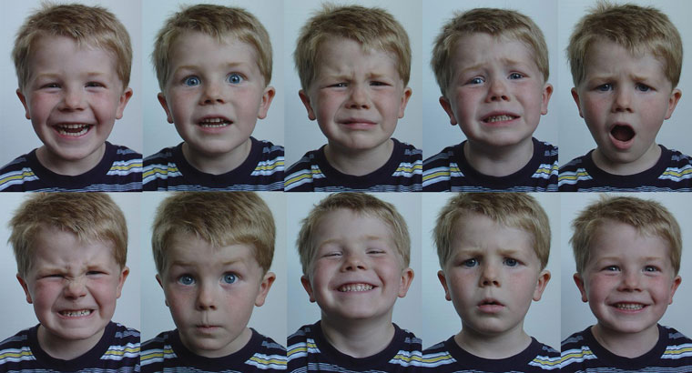
Facial Expressions

Slide 19
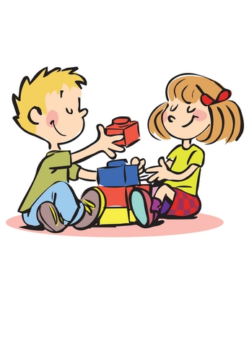
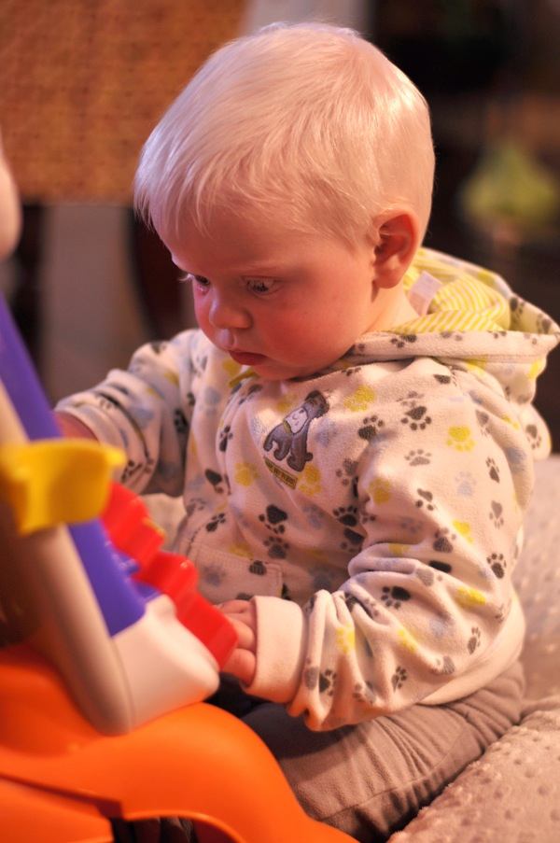
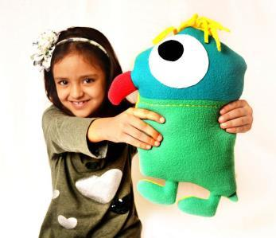
Showing and Shared Enjoyment

Slide 20
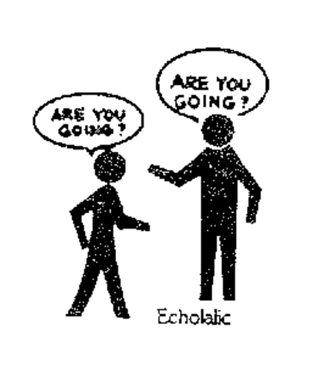
Idiosyncratic use of words Idiosyncratic language refers to language with private meanings or meaning that only makes sense to those familiar with the situation where the phrase originated.
Echolalia Part of typical language development greater frequency & longer period of time by children who are blind/VI

Slide 21
To recap-
FVA crucial
What is the clinical marker of ASD you are assessing?
What is the function behind said clinical marker?
What if any are the compensatory strategies used?
What can you attribute to VI?
What is typical for VI? What is atypical?
If you have a query re child/young adult on your caseload?
Email:
sineadfitzpatrick@childvision.ie
Our assessment service is open to any child/young person within the Republic of Ireland with a VI (not corrected by glasses) that has a query ASD co-occurring diagnosis.

