Slide 1
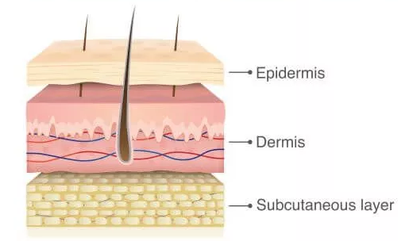
Dermatology: The Albinism Mum and Dermatology nurse perspective
Jo Foley CNS

Slide 2
What are the chances of getting skin cancer with Albinism?

Slide 3
Should we have yearly skin checks?

Slide 4
What to look for?

Slide 5
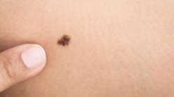
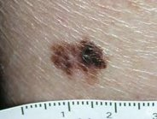
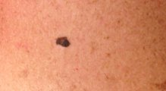

Slide 6
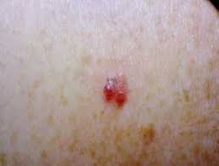
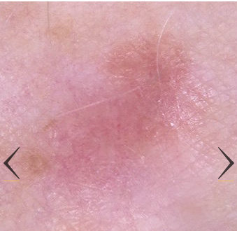

Slide 7
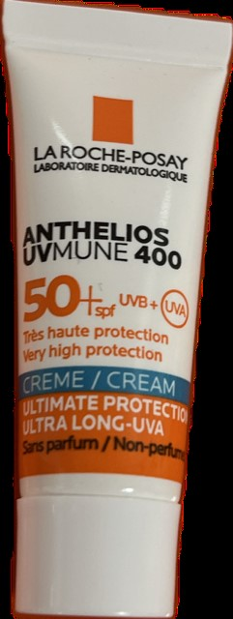
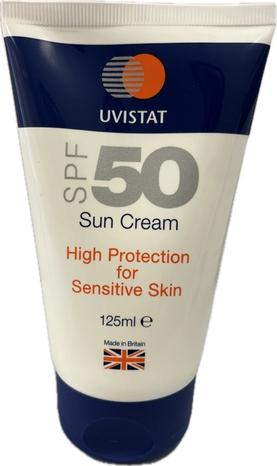
Sun cream know how?

Slide 8
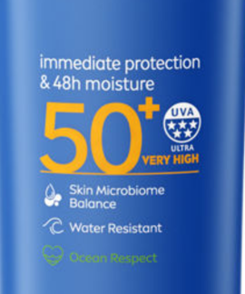

Slide 9
What should I do if I get burnt?

Slide 10
Vitamin D should we take it?

Slide 11
Advise for new parents
TAVI
Dermatology
Ophthalmology
Mobility officer
Bright things
Rope lights
Colour tube
Noisy toys

Slide 12
